Slide 1
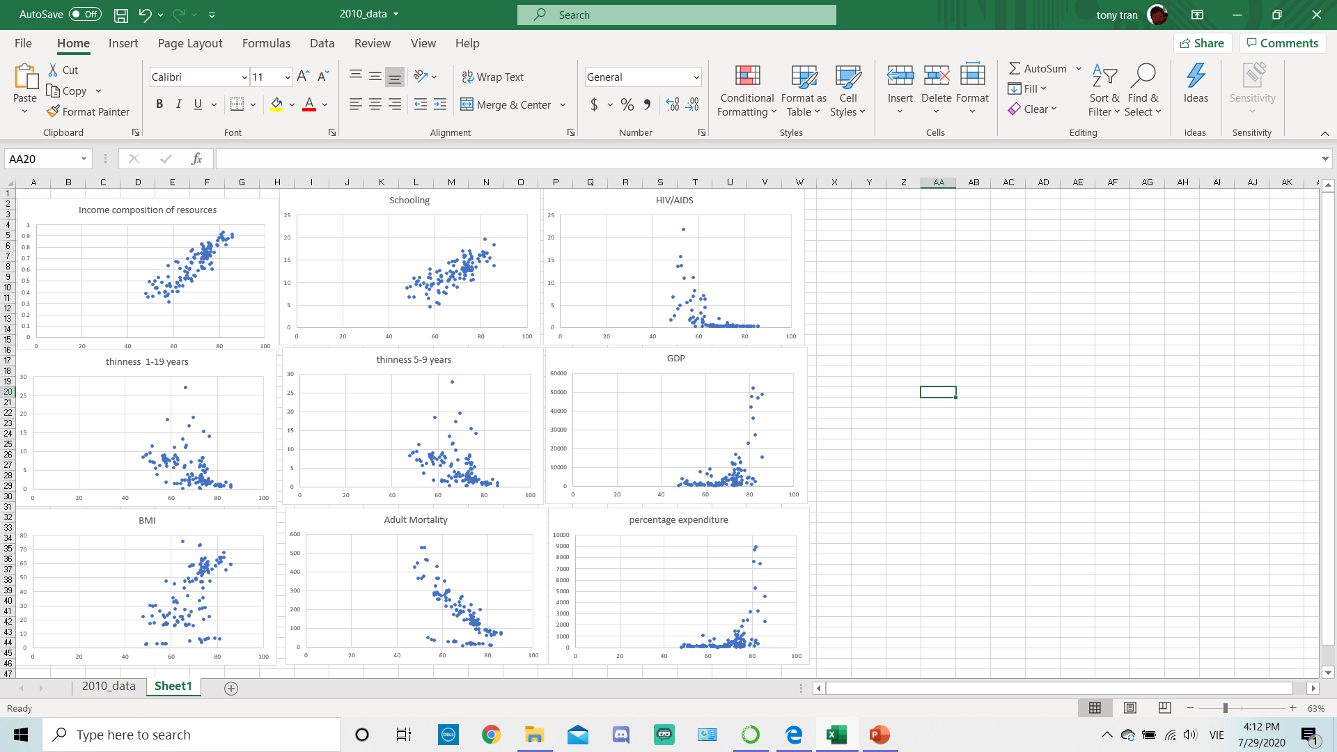

Slide 2
Using Linear Regression

Slide 3
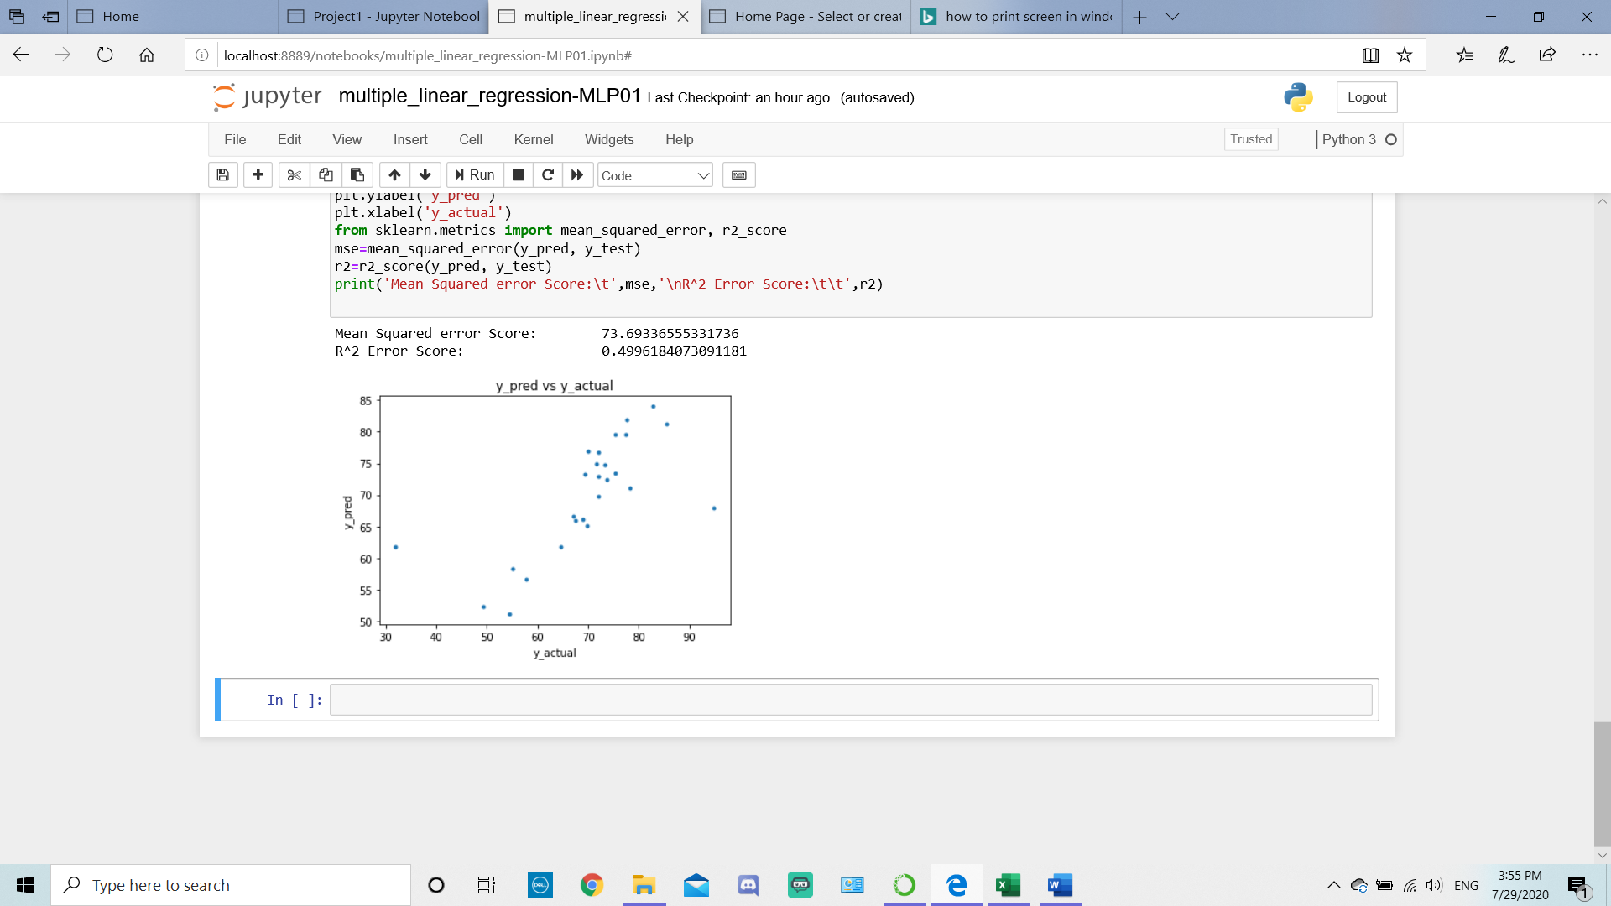
All X

Slide 4
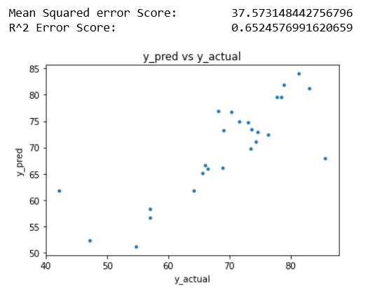
Adult Mortality percentage expenditure BMI HIV/AIDS GDP thinness 1-19 years thinness 5-9 years Income composition of resources Schooling

Slide 5
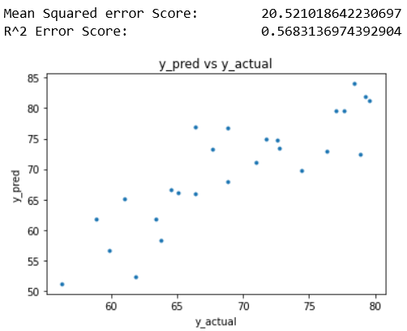
Income composition of resources Schooling

Slide 6
AFTER realizing 2 datapoints were really bad

Slide 7
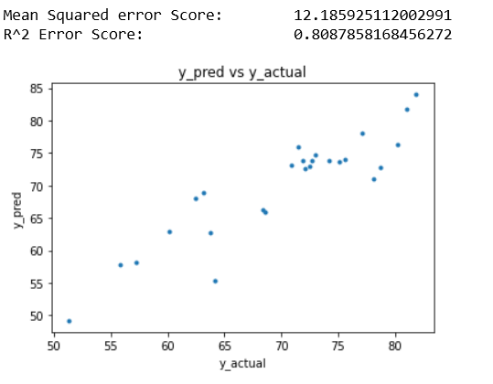
Adult Mortality percentage expenditure BMI HIV/AIDS GDP thinness 1-19 years thinness 5-9 years Income composition of resources Schooling

Slide 8
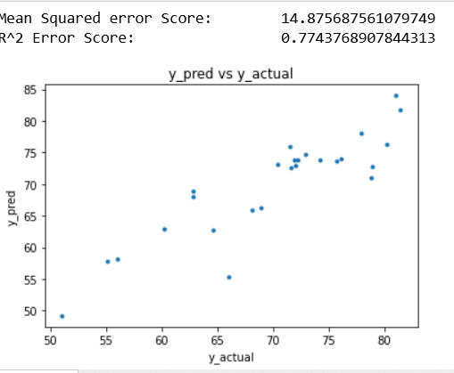
Adult Mortality Income composition of resources Schooling

Slide 9

Income composition of resources Schooling

Slide 10
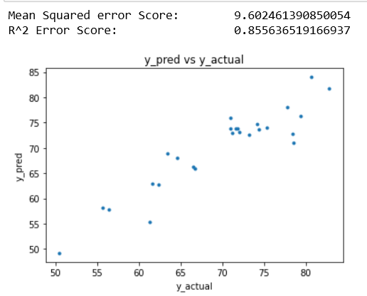
All X
I decided to go for the hail mary and see what happens if we put all the data into the code.
It somehow did better than just having 2 linear dataset, which was very surprising

